Slide 1


Course: Object Oriented Programming
Inheritance & Polymorphism
Reuse the common, specialize the rest
Evis Plaku

Slide 2


Inheritance & Polymorphism
Build flexible software by reusing code and extending behavior intelligently
Inheritance lets you define shared features once, then specialize
Polymorphism allows different types to work together through common interfaces
Essential for building scalable, maintainable systems that grow with requirements

Slide 3

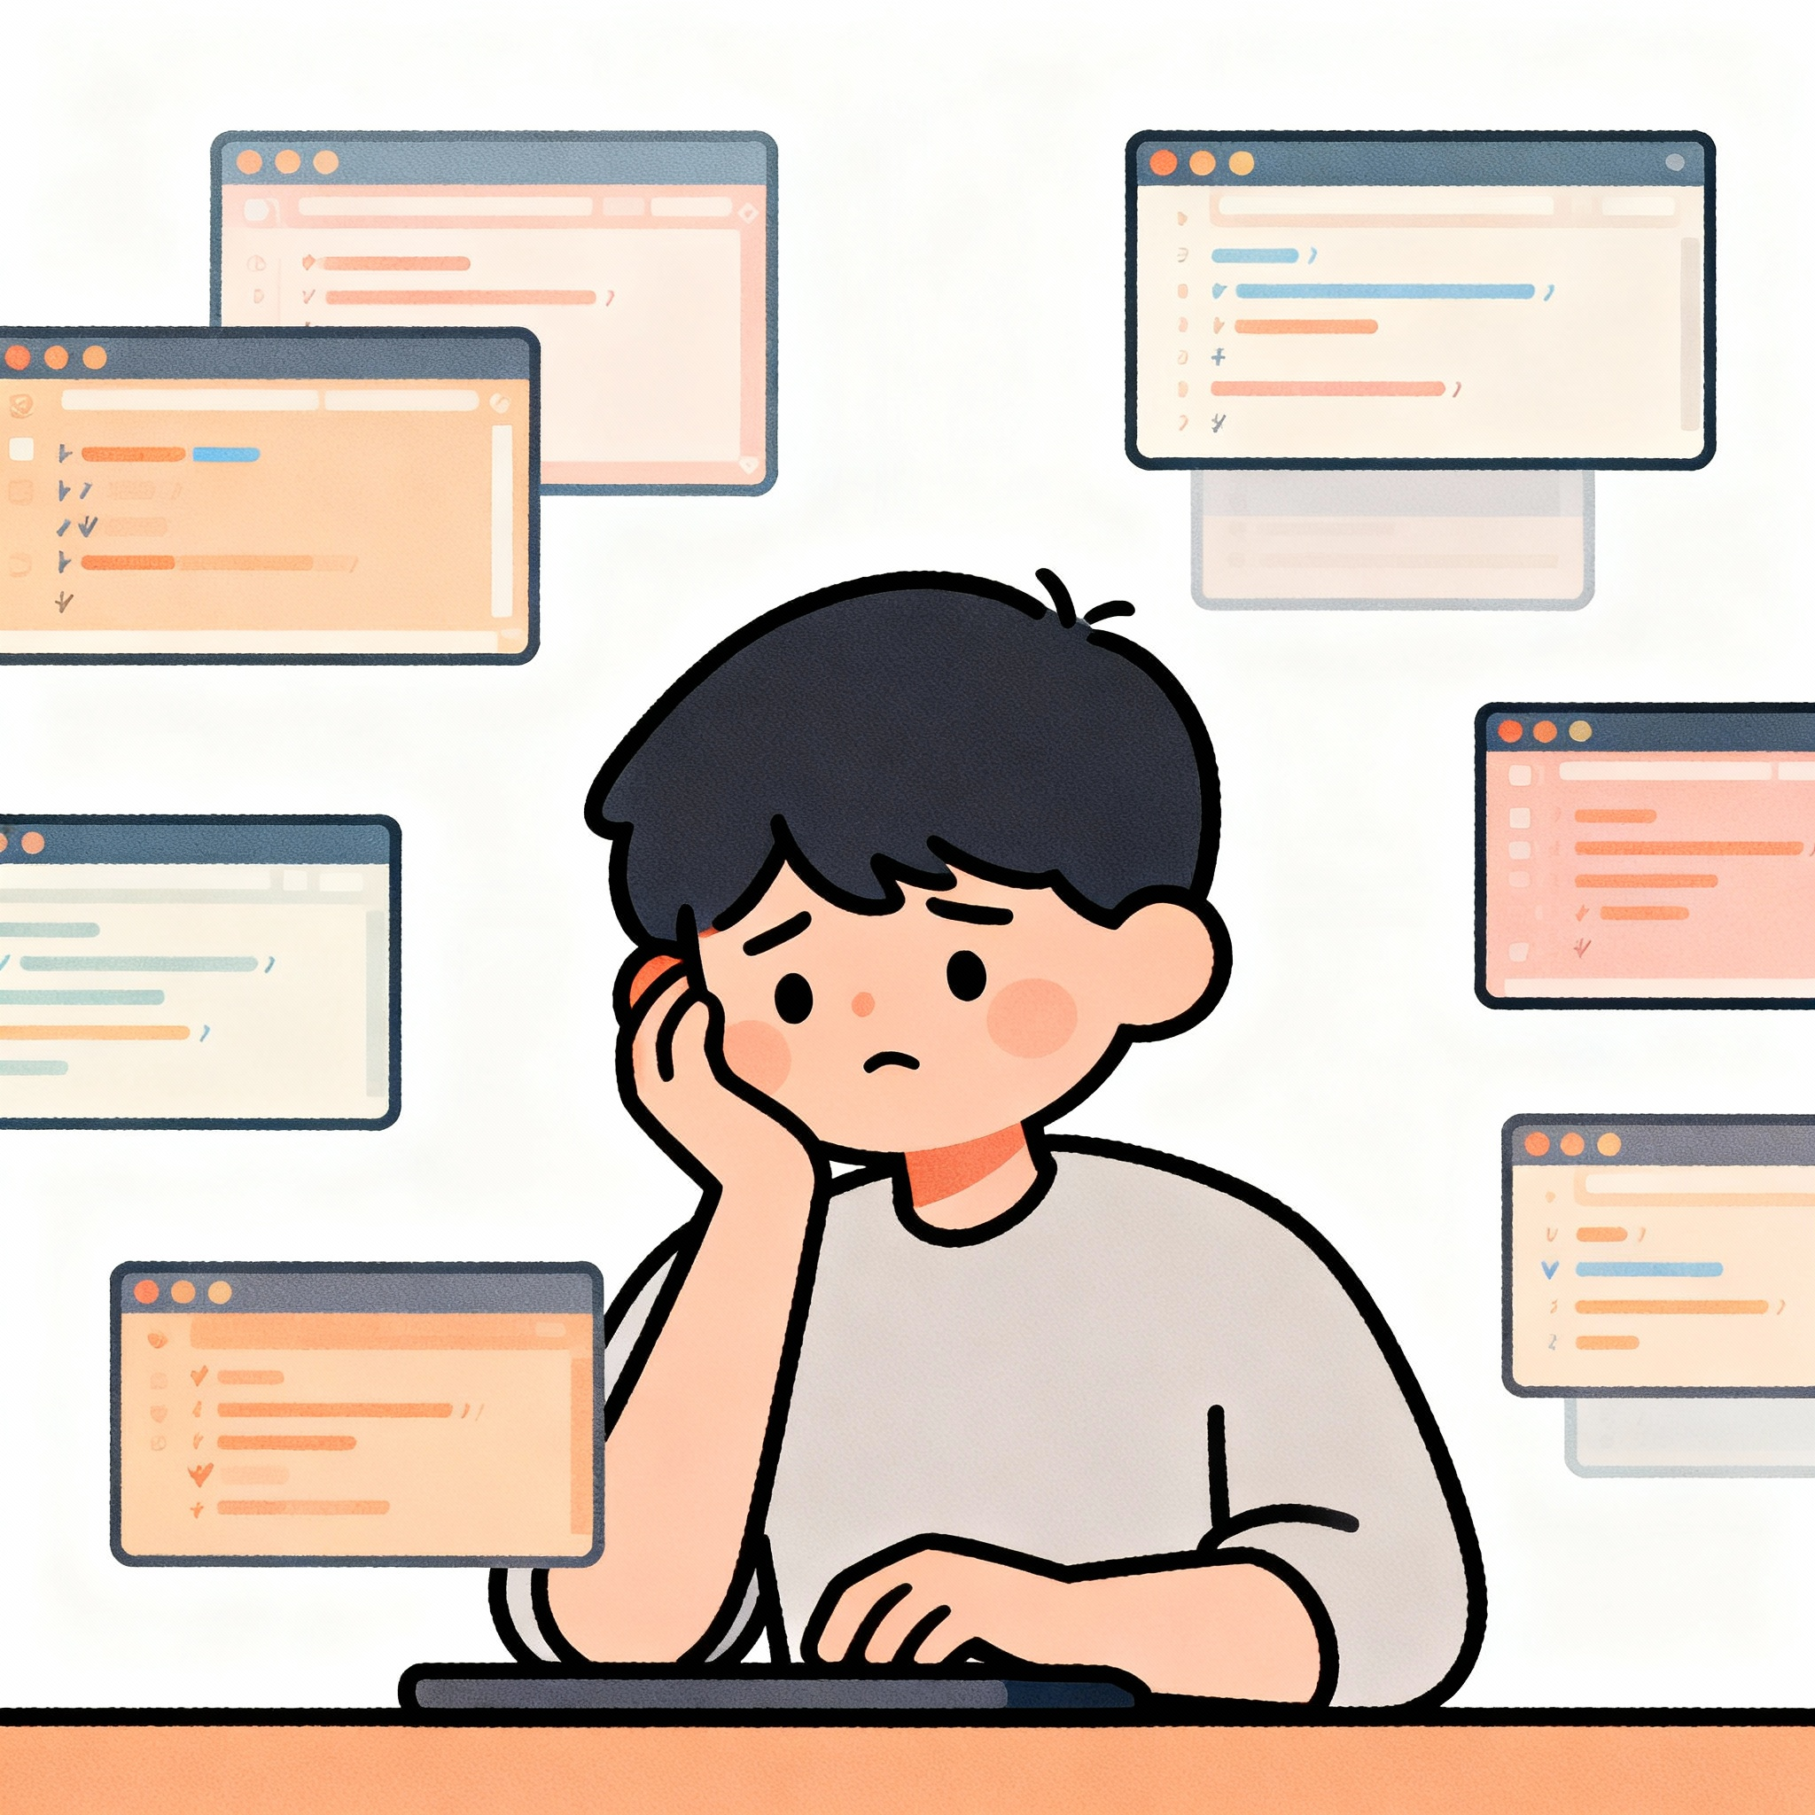
The code duplication problem
Copying similar code across classes creates maintenance nightmares and bugs
Similar entities share common features but differ in specific details
Copy-paste approach means fixing bugs in multiple places simultaneously
Adding new features requires updating every duplicated version individually

Slide 4

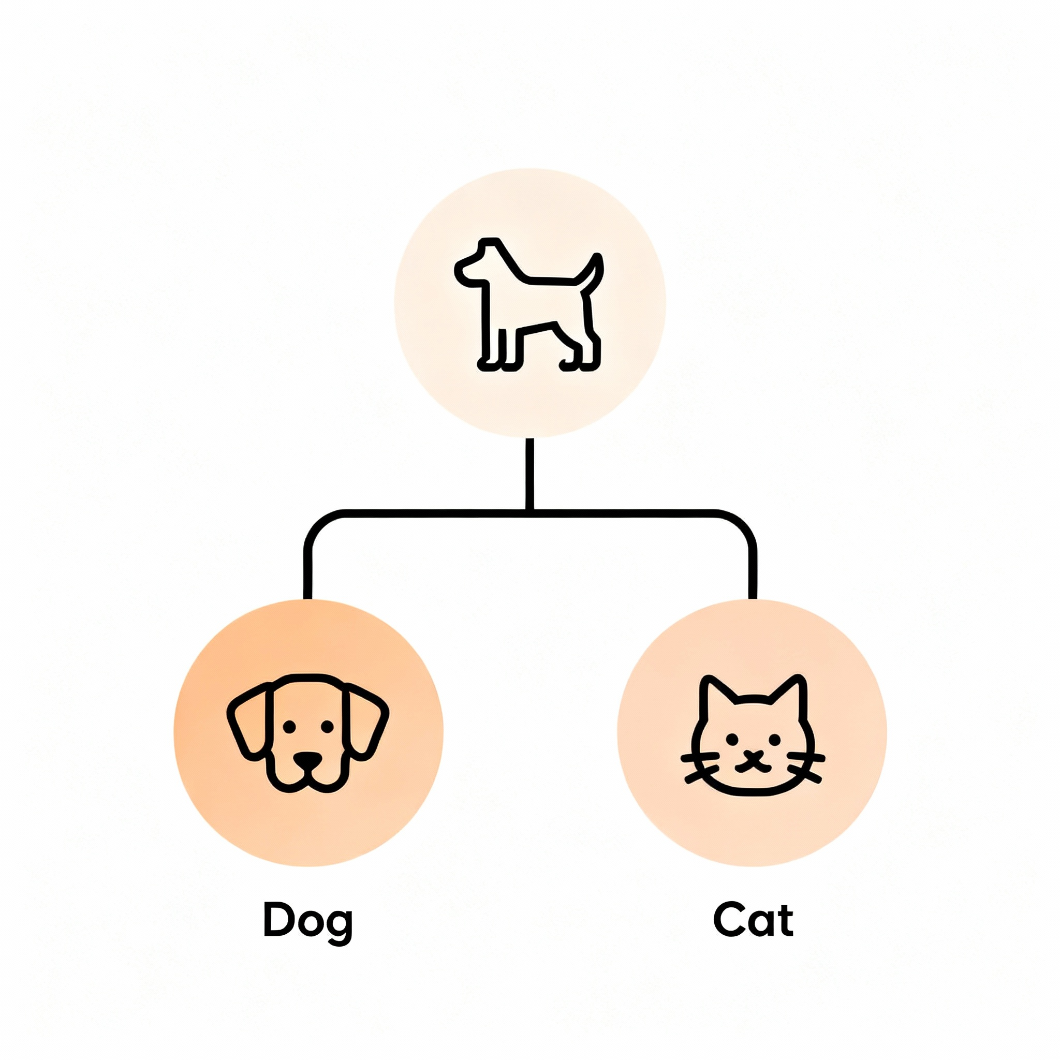
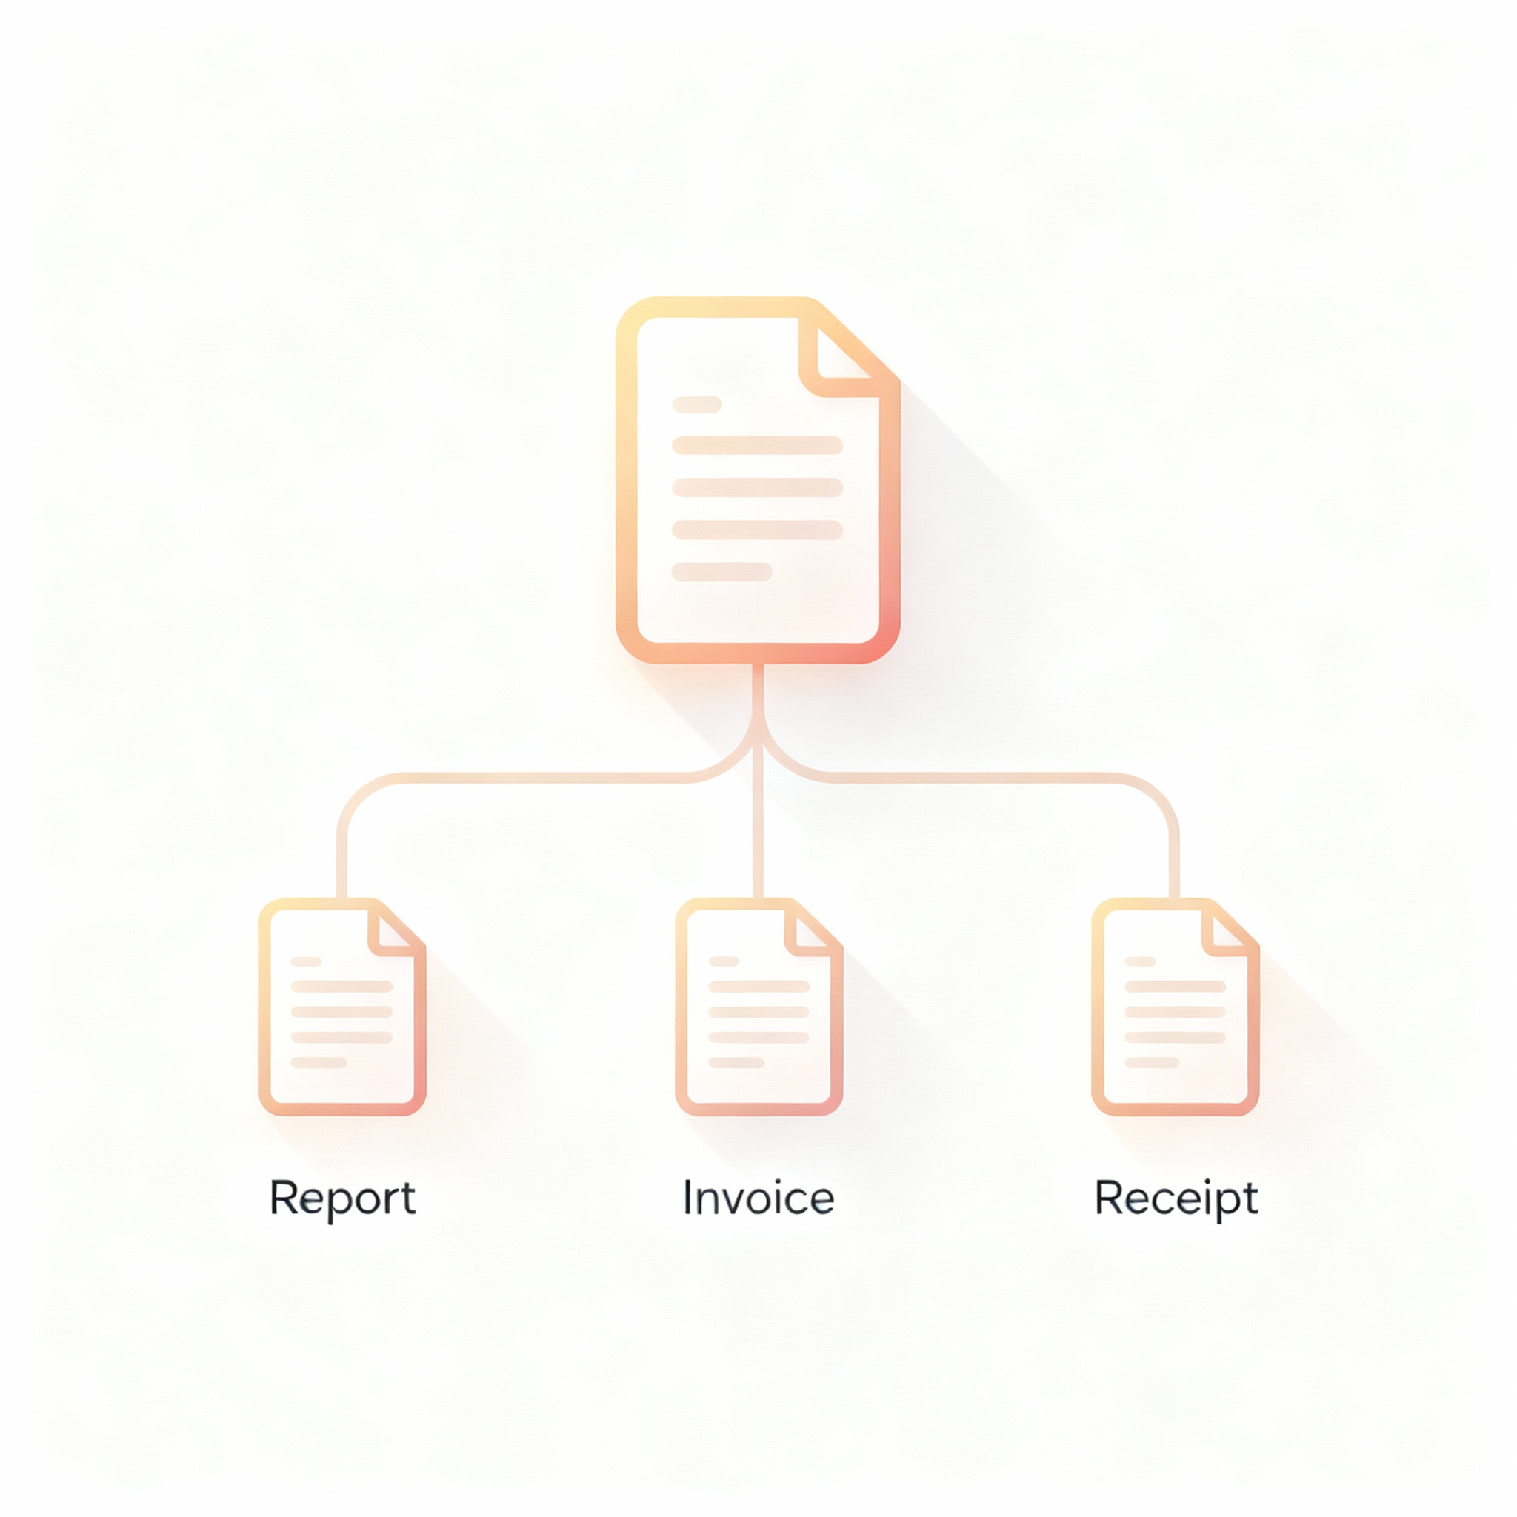
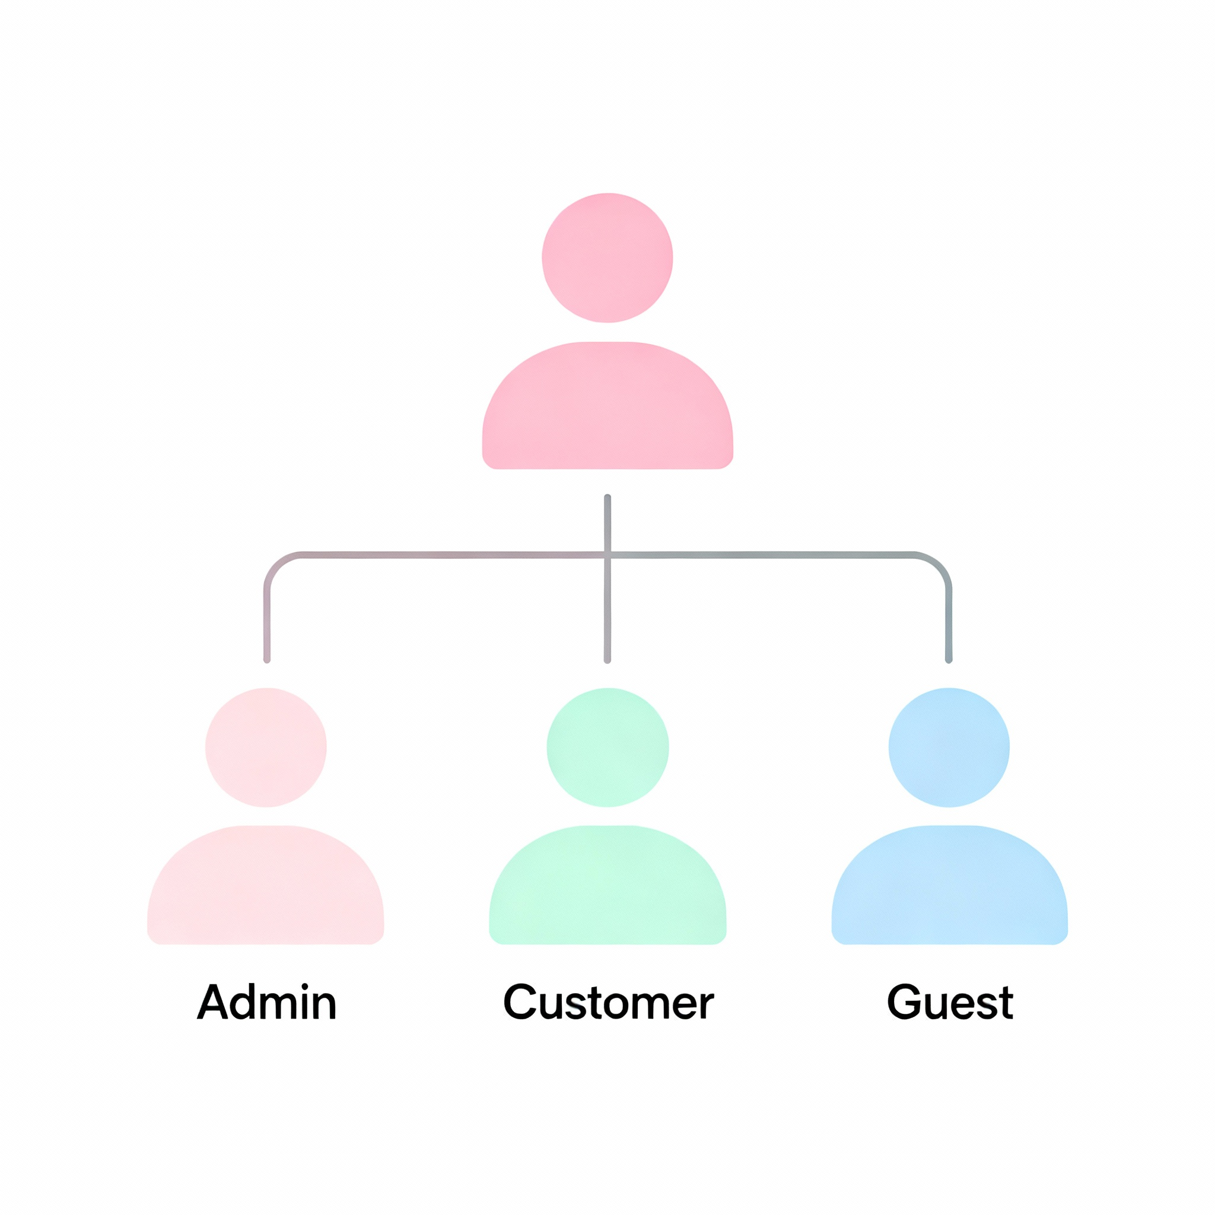
Real-World Category Hierarchies
Natural hierarchies move from general concepts to specific instances everywhere
Animals: Mammal → Dog, Cat; each adds specific traits
Documents: Document → Report, Invoice, Receipt; shared formatting, unique content rules
Users: User → Admin, Customer, Guest; common authentication, different permissions

Slide 5


The DRY Principle
Don't Repeat Yourself define shared behavior once in the parent class
Write common logic in one place; all children inherit automatically
Bug fixes and improvements propagate to all specialized types instantly
Reduces codebase size, increases consistency, simplifies maintenance significantly

Slide 6

What You'll Learn Today
Learn inheritance for code reuse and polymorphism for flexible design
Create parent classes that capture shared structure and behavior
Build specialized child classes that extend and customize parent functionality
Use polymorphism to write code that works with current and future types

Slide 7
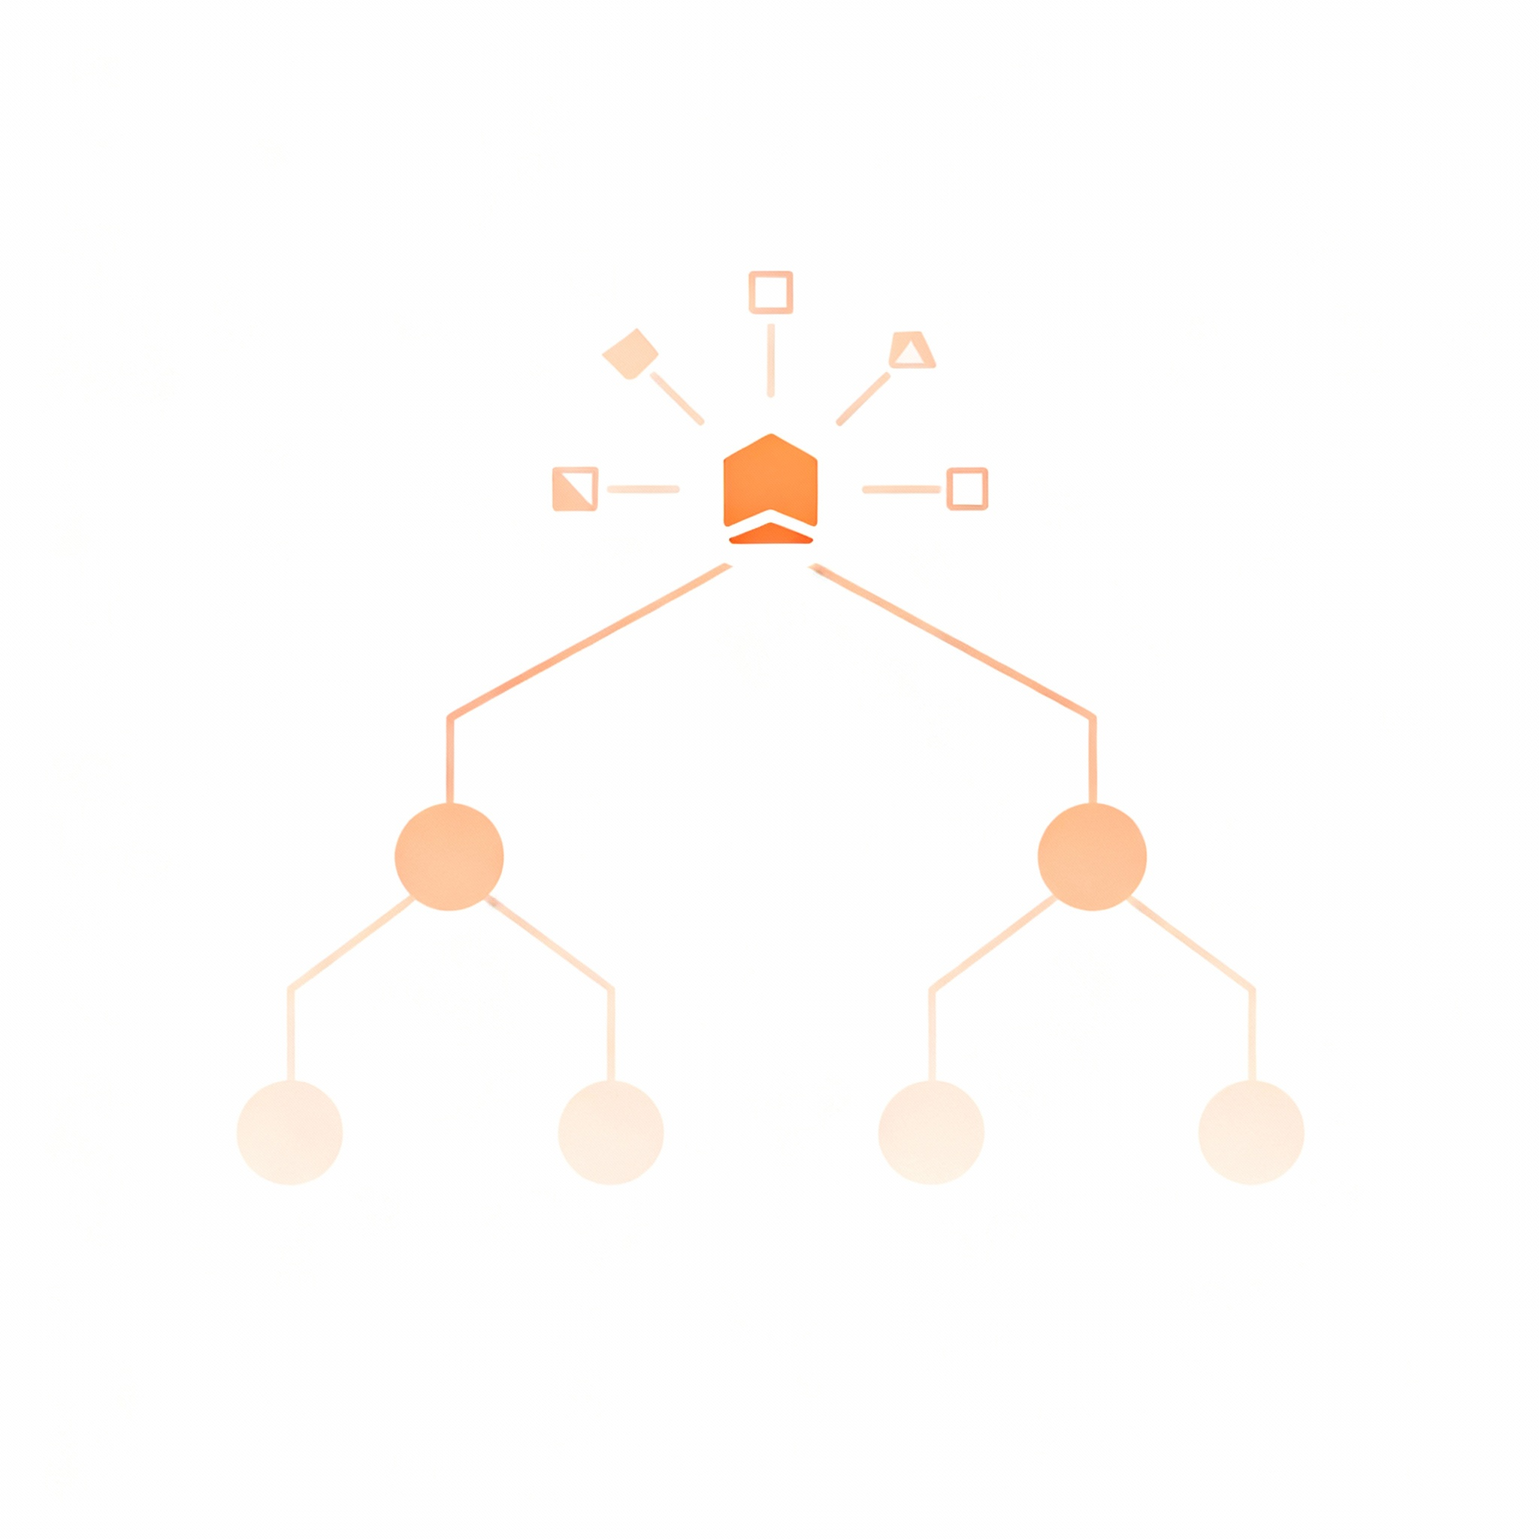
Core Concepts

Slide 8

Inheritance Basics
Parent class defines common features; children inherit and add specifics
Superclass (parent) contains fields and methods shared by all children
Subclass (child) uses extends keyword to inherit everything from parent
Creates "is-a" relationship Student IS-A Person, Employee IS-A Person
IS - A

Slide 9
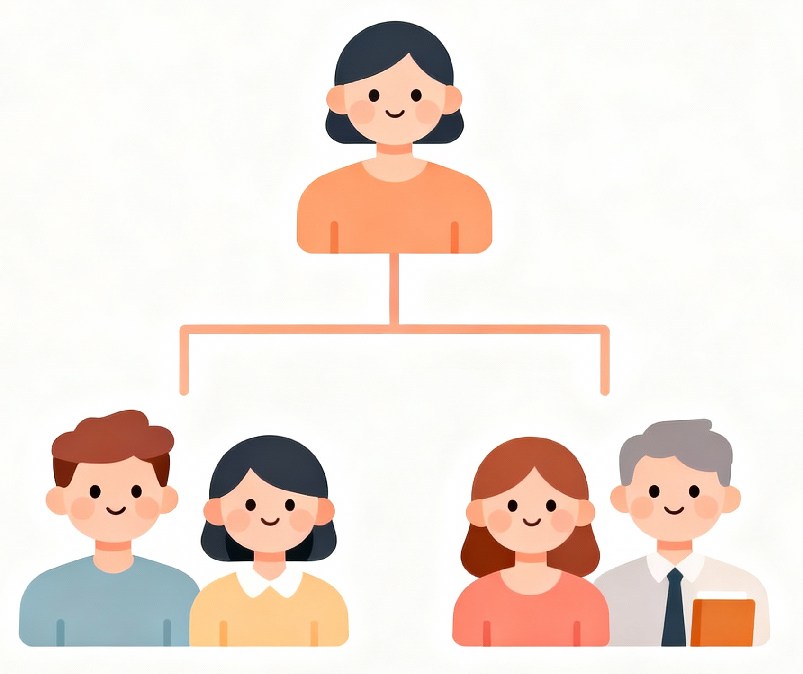
Person Hierarchy Example
Person holds name and age Student and Employee add specialized fields
Person
Person: id, name, age, address, displayInfo() method
Student adds: major, GPA tracking
Employee adds: salary, department, employee benefits
Student
Employee

Slide 10

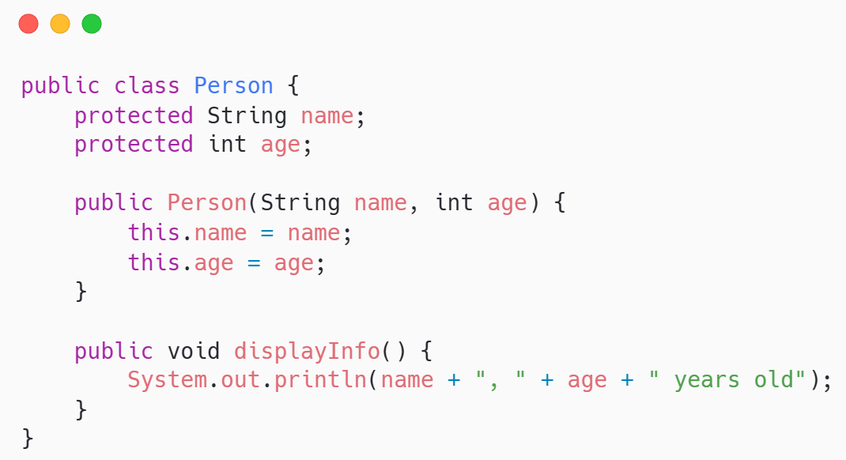

Code example: person class
Base class defines common state and behavior all people share
protected allows subclasses to access these fields directly
Constructor initializes common data every person needs
displayInfo() provides default behavior children can override

Slide 11

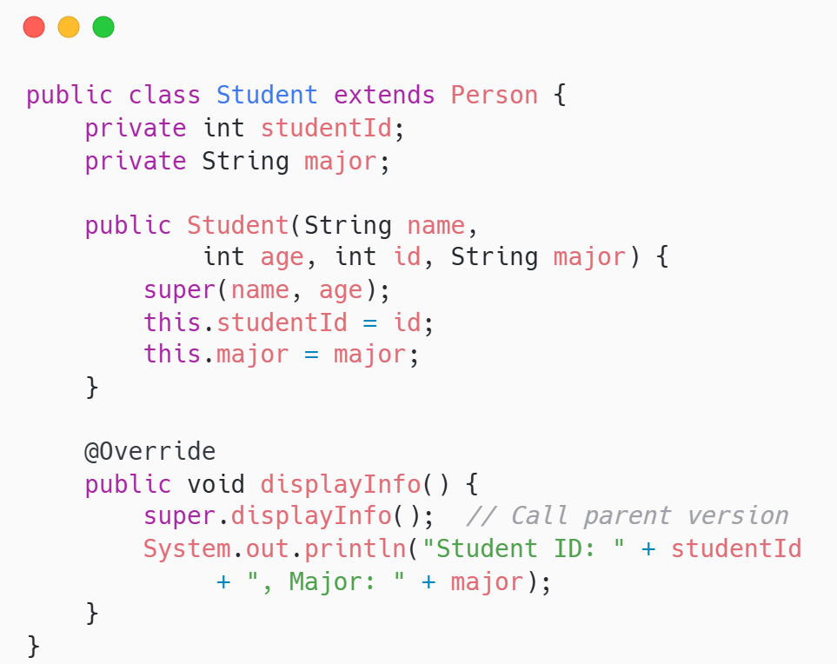
Code example: Student extends person
Student inherits Person's fields and adds student-specific data and behavior
extends Person establishes inheritance relationship
super(name, age) calls parent constructor to initialize inherited fields
Override displayInfo() to add student-specific details after parent information

Slide 12


The super keyword
Access parent constructors and methods from within child classes using super
super() calls parent constructor; must be first line in child constructor
super().methodName calls parent's version of an overridden method
Ensures parent initialization happens before child adds its own setup
Parent
super
Child

Slide 13
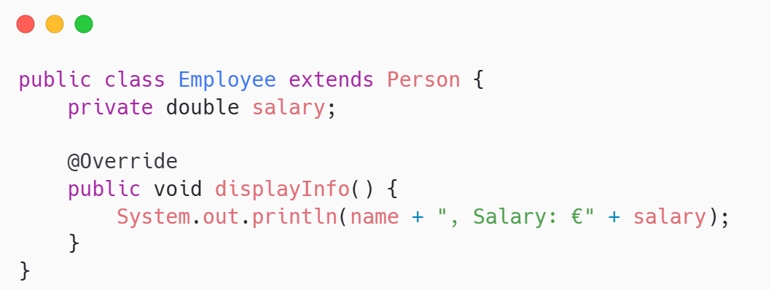
Method overriding
Children replace parent method implementations to provide specialized behavior
@Override annotation tells compiler you're replacing parent method
Method signature must match parent exactly (name, parameters, return)
Child's version executes when called on child objects

Slide 14


Protected Access Modifier
Protected fields are accessible within class, subclasses, and same package
private: only this class sees it
public: everyone everywhere can access it
protected: this class, all subclasses, and package classes

Slide 15

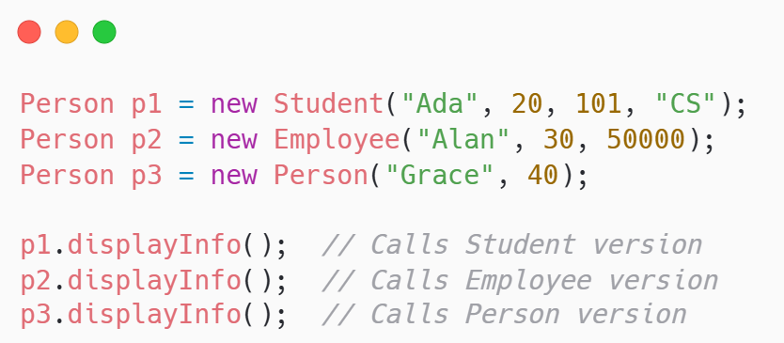
Polymorphism introduction
Parent references can hold child objects; behavior resolves at runtime
Parent type Person holds any child type object
Method calls execute child's version automatically
Decided at runtime based on actual object type

Slide 16
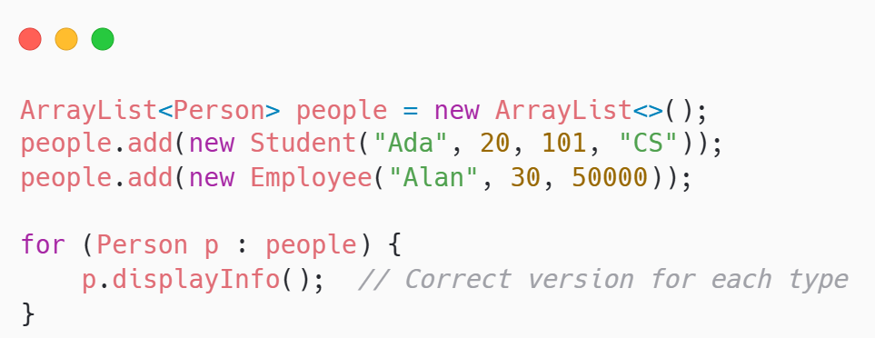
Polymorphism Example - User Collections
Single collection holds mixed types; each behaves according to actual class
ArrayList<Person> accepts Student, Employee, and Person objects
Loop treats all uniformly as Person references
Each object executes its own displayInfo() implementation automatically

Slide 17
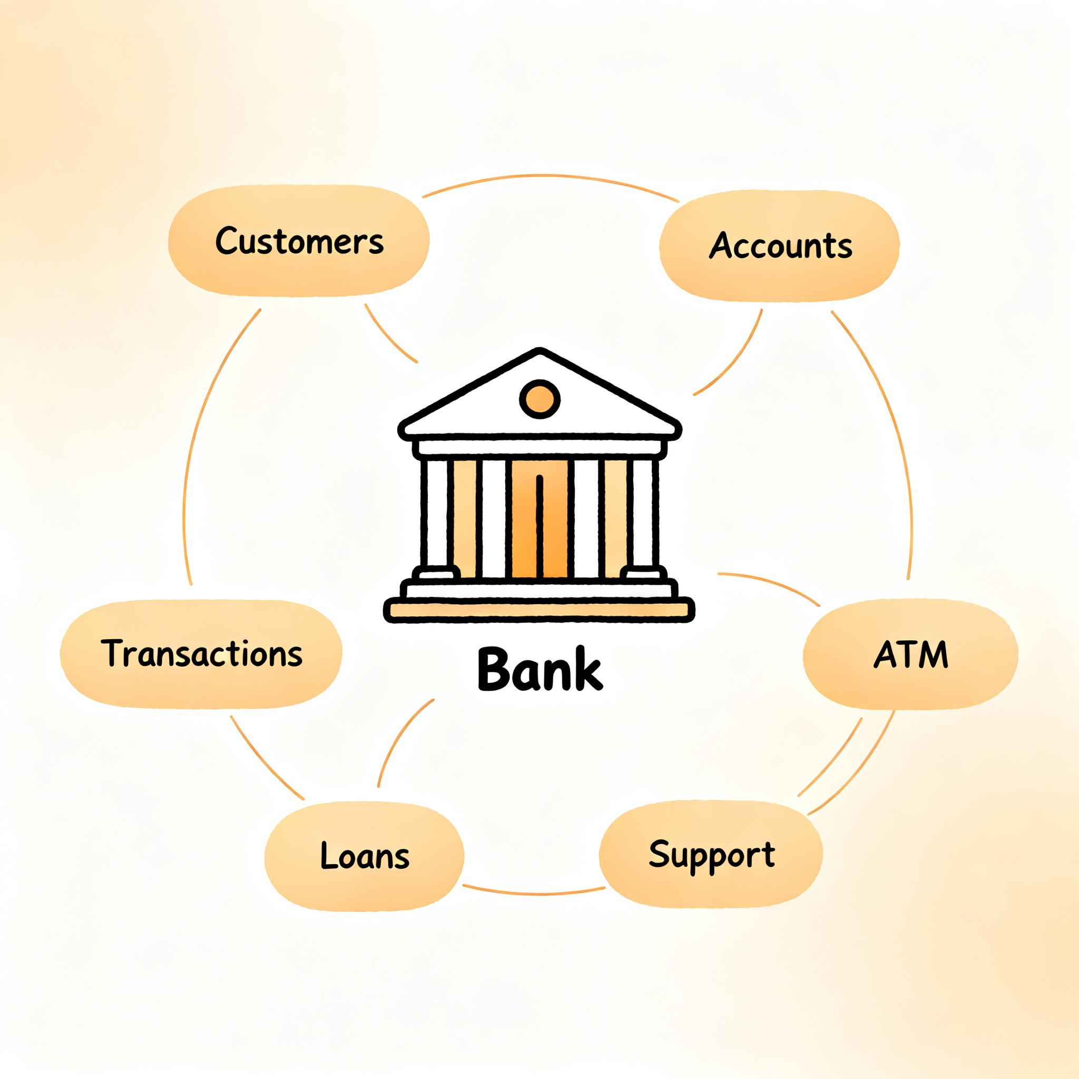
Bank System Example

Slide 18

Why Inheritance for Accounts
Multiple account types share core banking operations but differ in rules
CheckingAccount, SavingsAccount, InvestmentAccount all need balance tracking and transactions
Each type enforces different withdrawal rules and business constraints
Inheritance captures commonality Overriding customizes behavior per account type

Slide 19

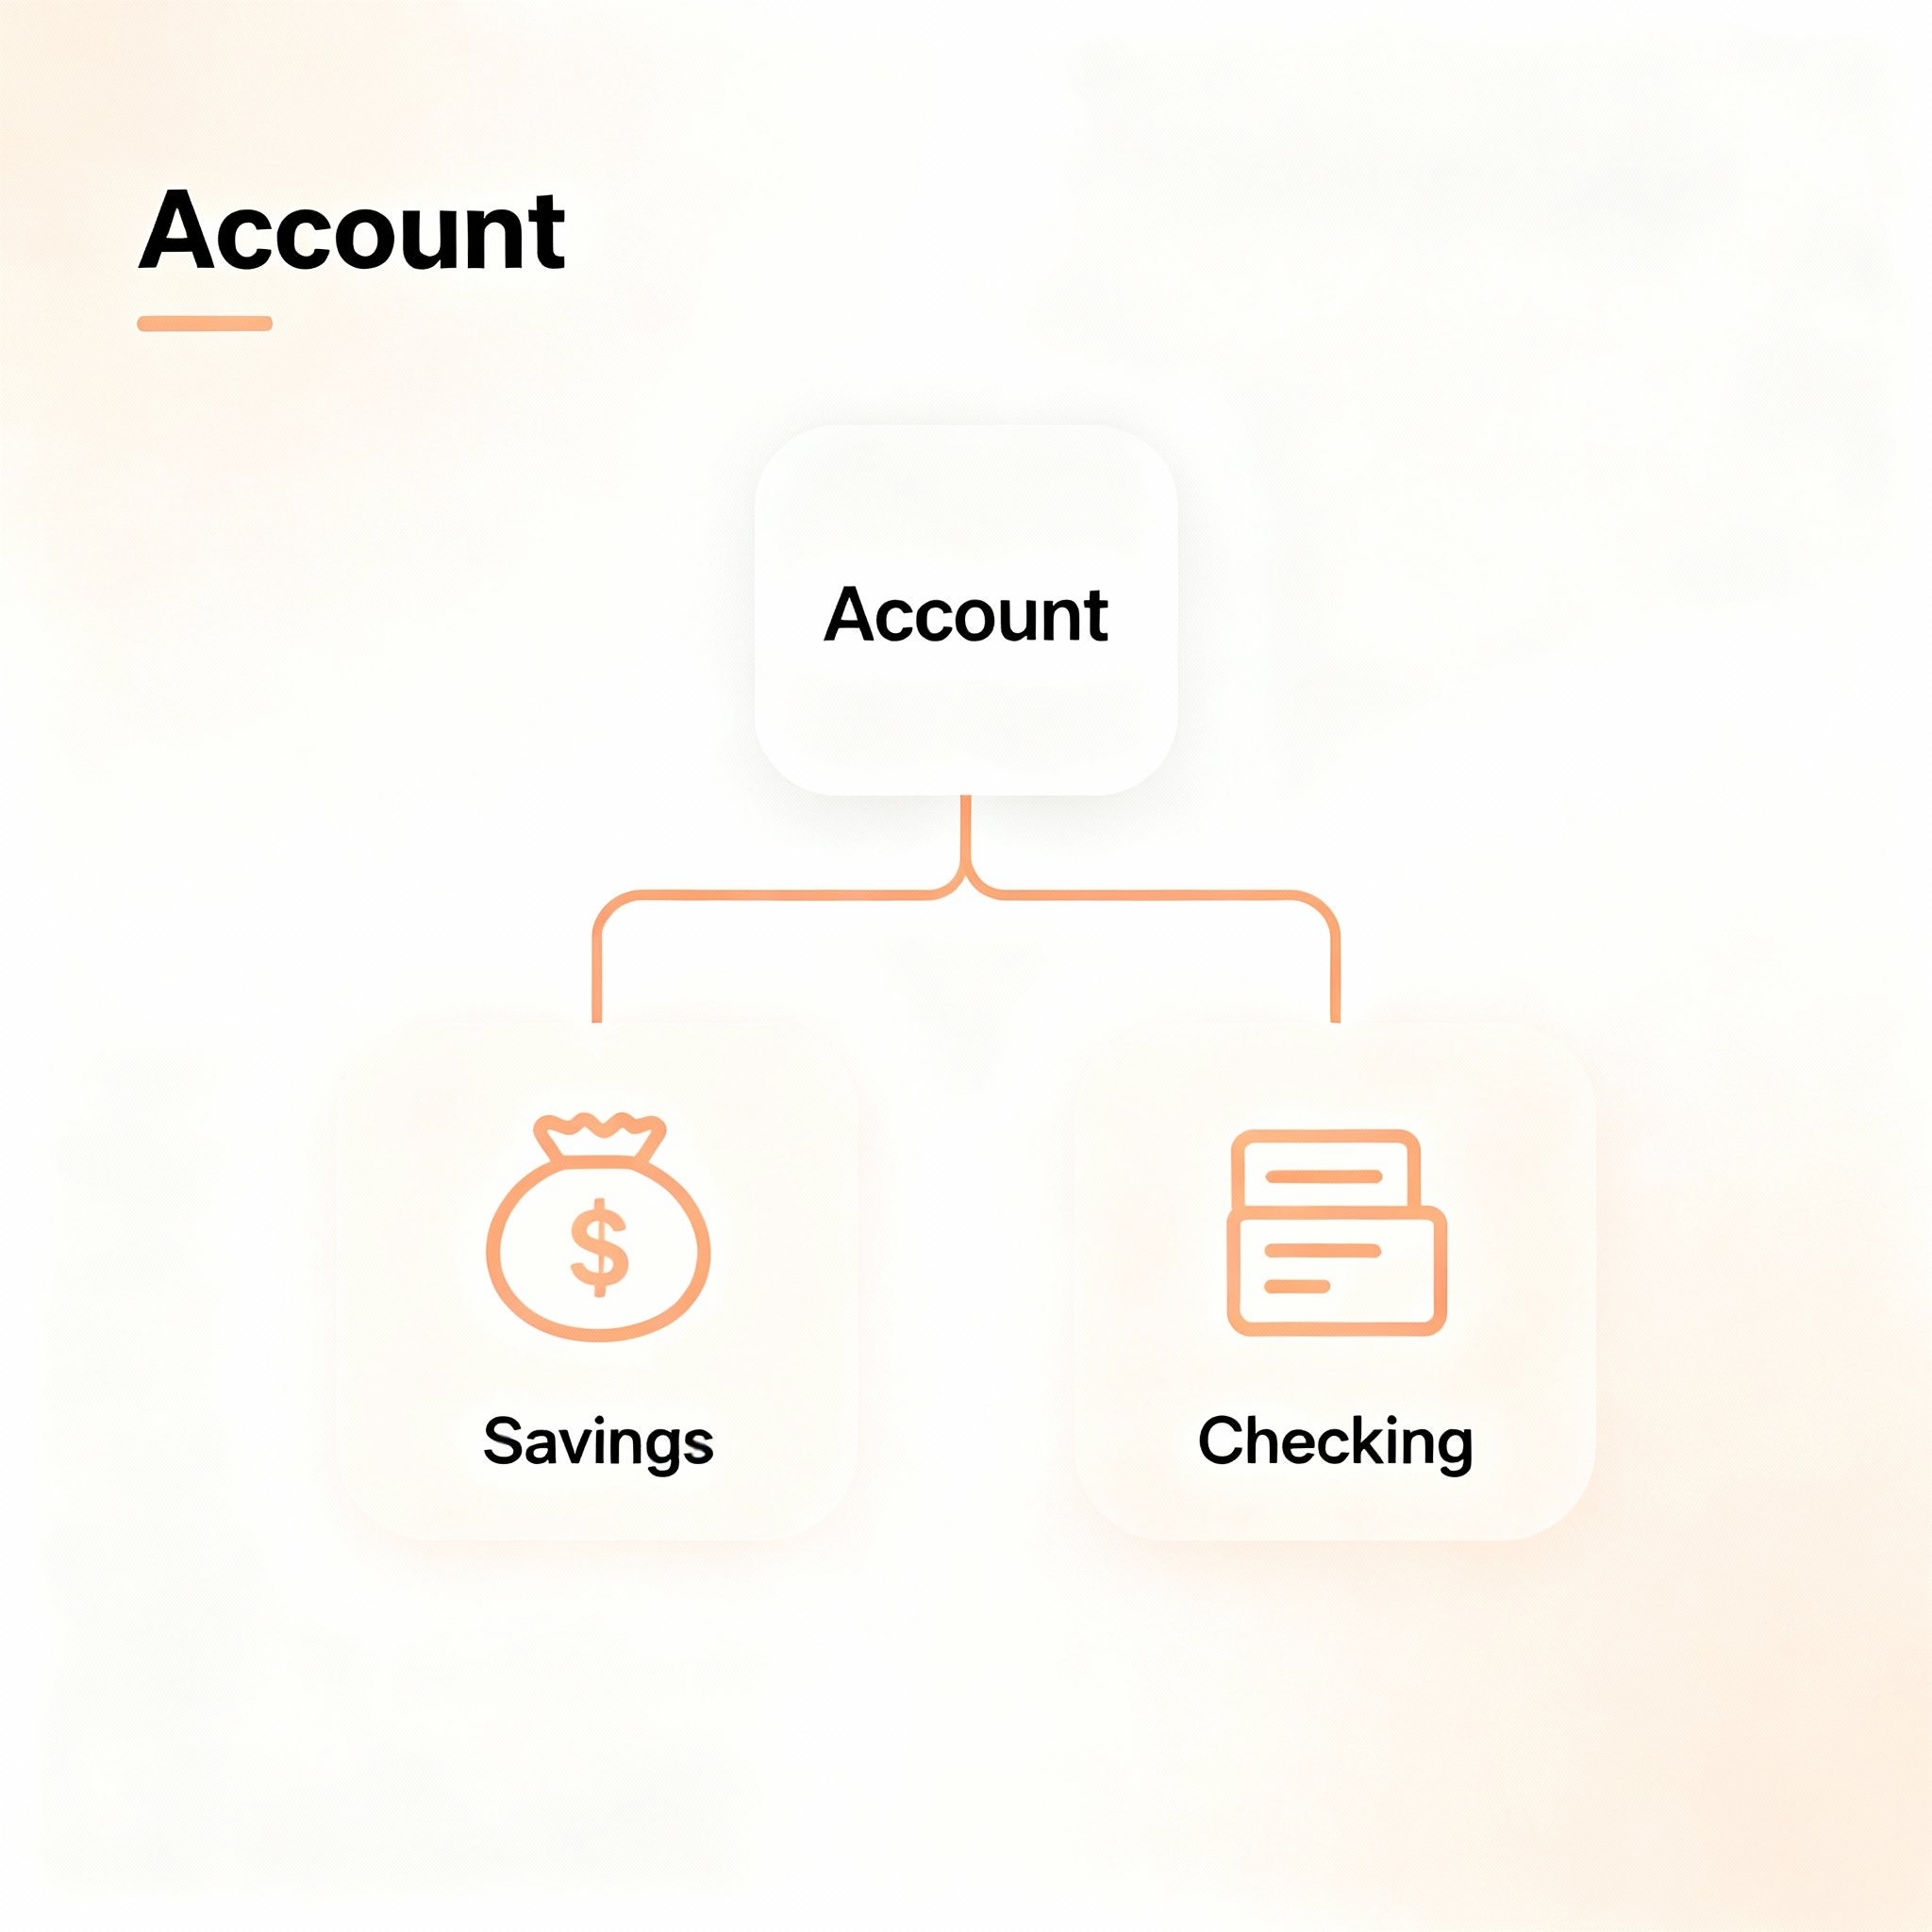
Account Hierarchy Design
Base Account holds shared fields children add type-specific features and rules
Account base class: accountId, balance, isFrozen, deposit(), withdraw()
CheckingAccount: adds overdraft limit for negative balances
SavingsAccount: adds interest rate and minimum balance enforcement

Slide 20
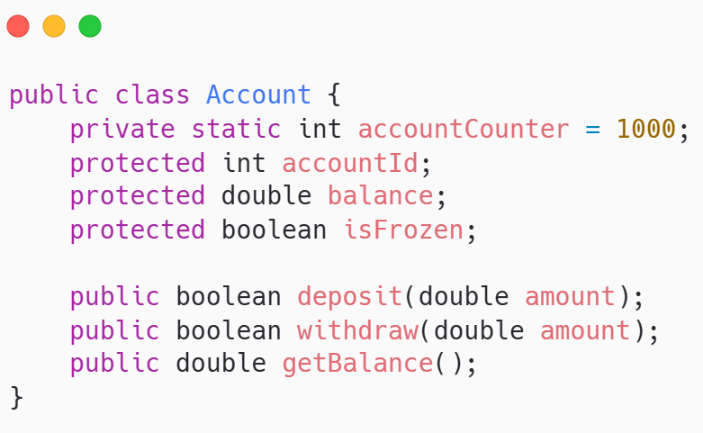
Base Account Class Structure
Common fields and operations all account types share in one place
Static counter generates unique IDs automatically
Protected fields allow subclasses direct access when needed
Base withdraw() prevents overdrafts; children can override

Slide 21

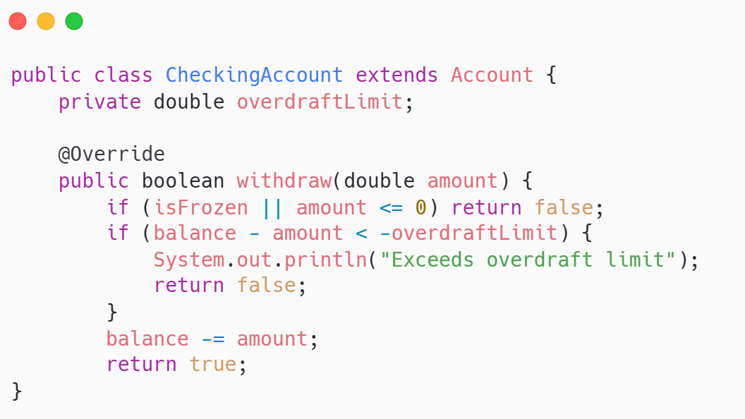
CheckingAccount Extends Account
Checking accounts allow overdrafts up to a specified limit for flexibility
Adds overdraftLimit field not present in base Account
Overrides withdraw() to allow negative balance up to limit
Calls super() to initialize parent Account fields first

Slide 22

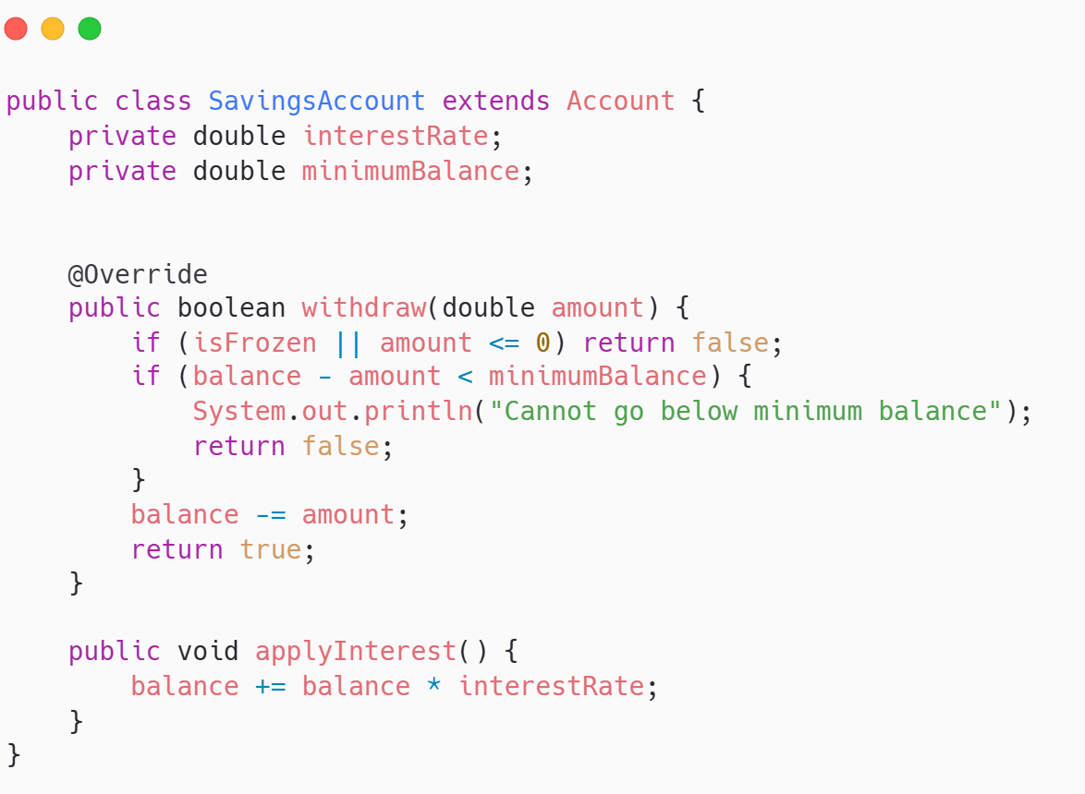
SavingsAccount Extends Account
Savings accounts enforce minimum balance and calculate interest on deposits
Adds interestRate and minimumBalance constraints
Override withdraw() to enforce minimum balance rule
New method applyInterest() specific to savings accounts only

Slide 23

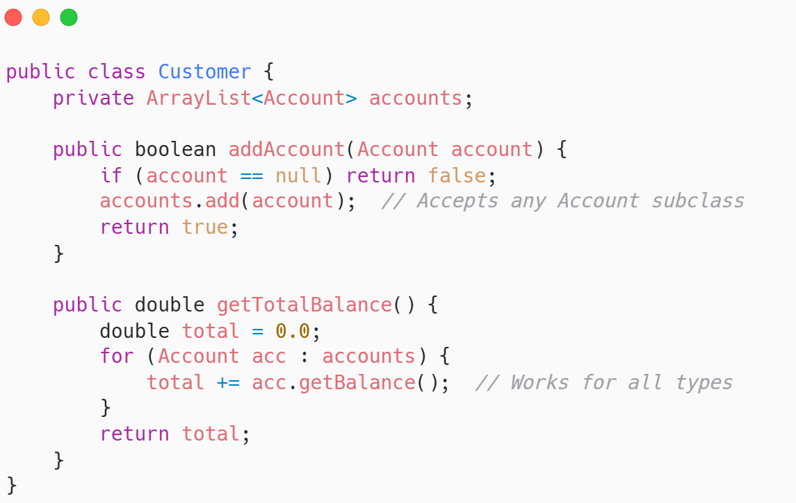
Polymorphic Customer Portfolio
Customer's account list holds all account types; single collection manages diversity
List holds all types of Account objects
addAccount() works with any current or future subclass
getTotalBalance() treats all types uniformly

Slide 24
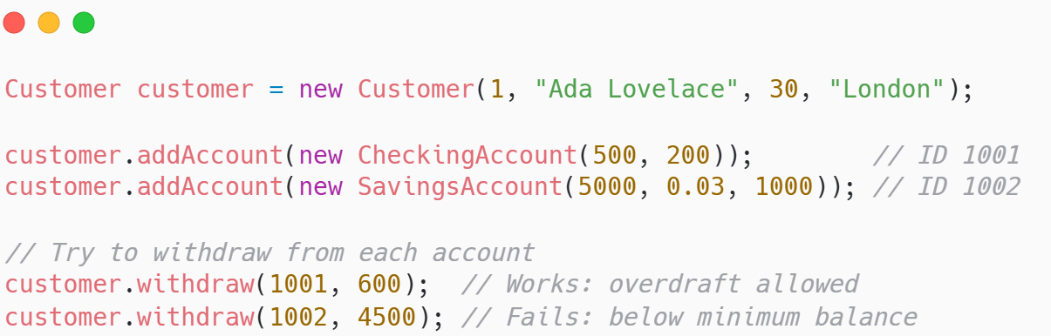
Runtime Polymorphism Demo
Each account type executes its own validation rules when withdraw() is called
Same withdraw() call behaves differently for each account type
CheckingAccount checks overdraft limit
SavingsAccount checks minimum balance

Slide 25


Benefits in Our System
Add new account types without changing existing Customer or main code
Customer code works with all current and future Account types
getTotalBalance(), displayAllAccounts() handle any account automatically
New type? Extend Account, override what's needed, add to system

Slide 26


Key Takeaways & Next Steps
Inheritance eliminates duplication polymorphism enables flexibility and extensibility
Write shared code once in parent; children inherit and specialize
Treat different types uniformly while preserving unique behavior
Banking system now handles diverse account types elegantly and extensibly

Slide 27


Quote of the week
Grow from strong roots Branch with purpose

